Slide 1

Digital Twin

Slide 2

Introduction, group, choice. Exploring the data

Slide 3

DIGITAL TWIN

Slide 4
DIGITAL TWIN

Slide 5

Digital

Slide 6
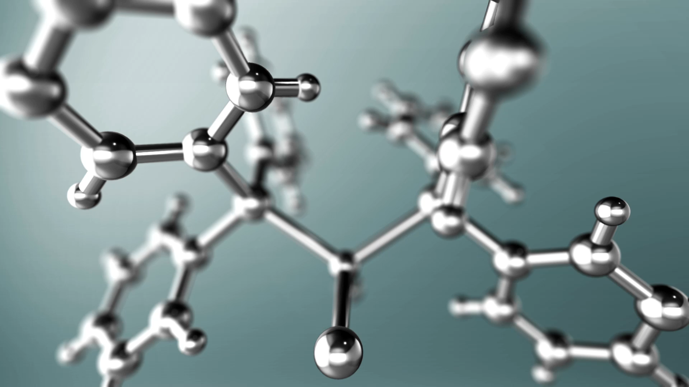
Neural Network

Slide 7
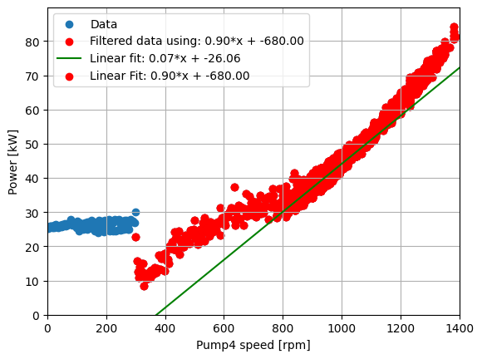
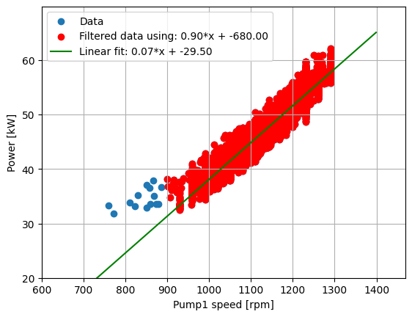
DIGITAL TWIN
Power vs. Pump 4
Power vs. Pump 1

Slide 9

Static models
Power vs. Pump 4
Power vs. Pump 1

Slide 10
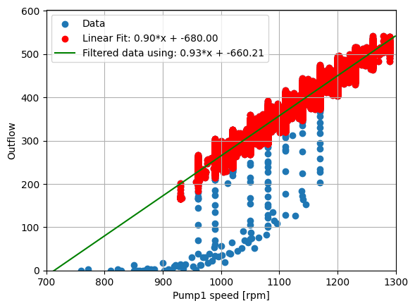
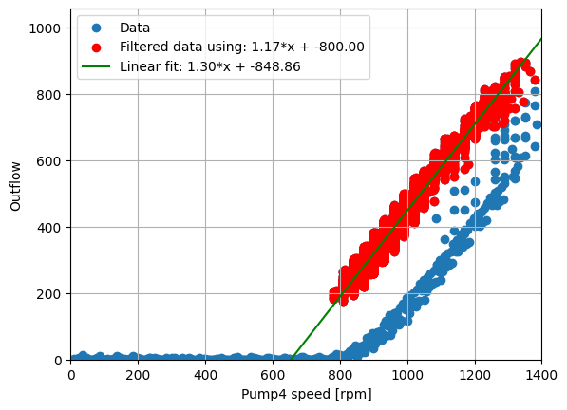
Static model

Slide 11
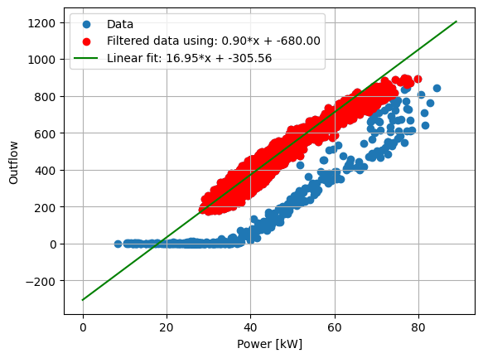
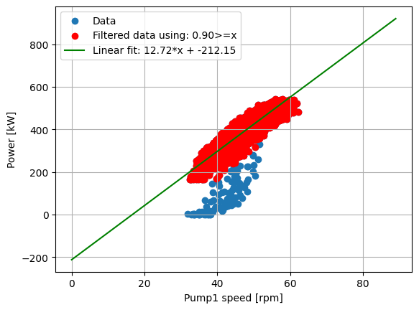
Static model

Slide 12
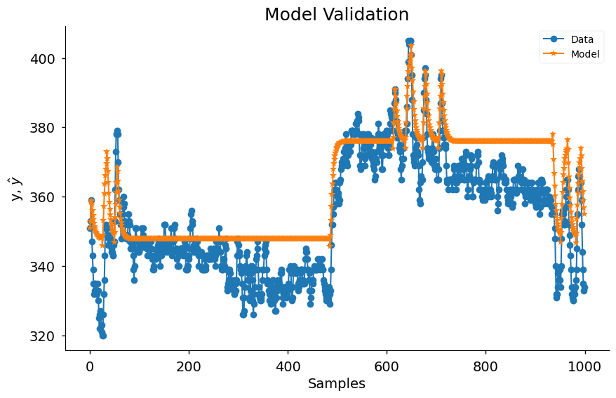
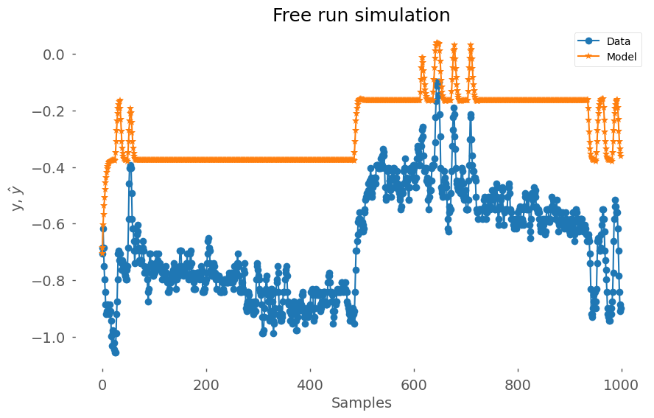
ARX
NN

Slide 13
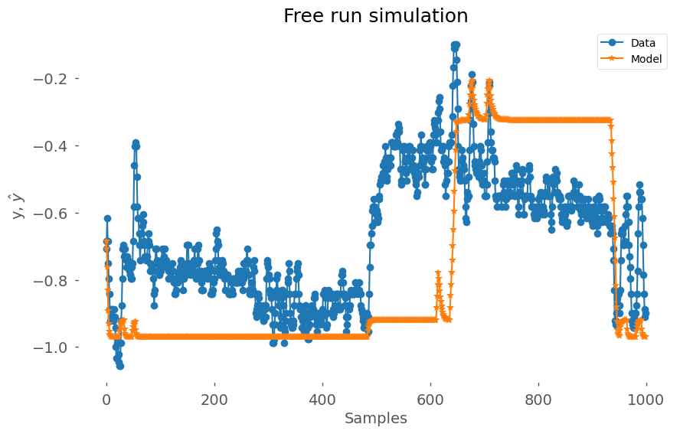
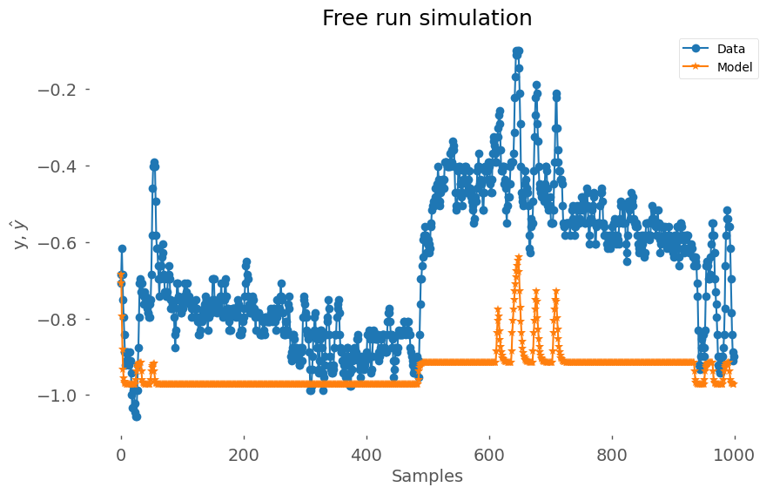
NN training parameters
5 epochs, MSE = 0.1506
3 epochs, MSE = 0.1183

Slide 14
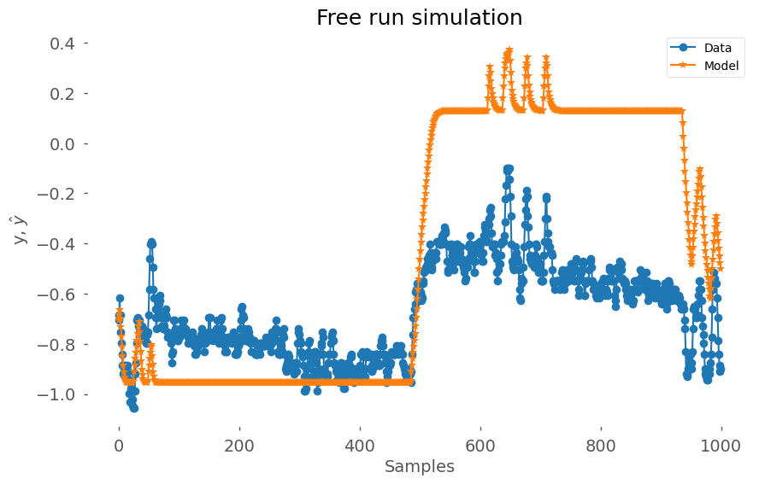
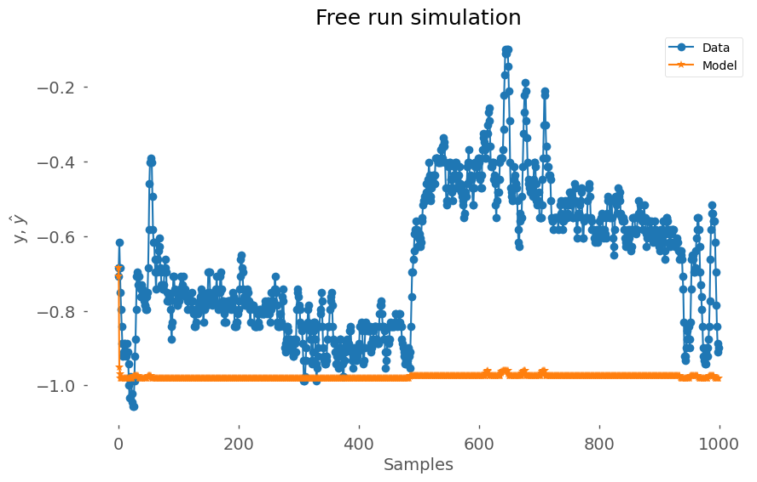
NN training parameters
10 epochs, MSE = 0.2536
1 epochs, MSE = 0.4071

Slide 15
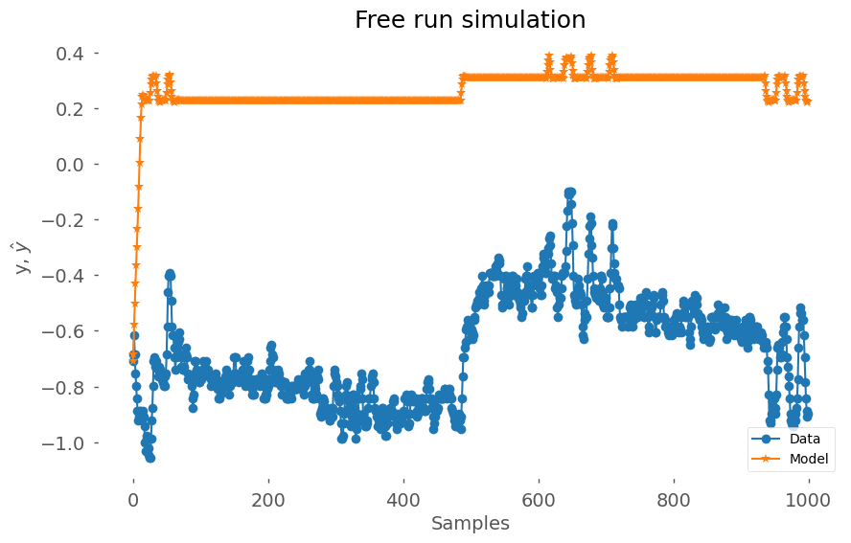
NN training parameters
20 epochs, MSE = 0.5001
3 epochs, MSE = , 2 HL x 4 neurons

Slide 16
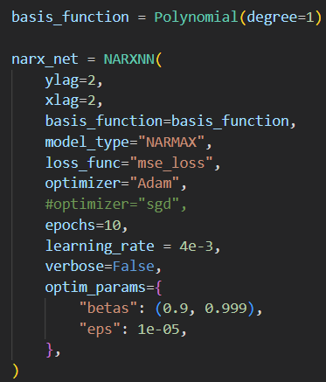
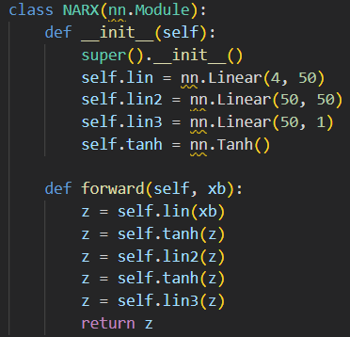
NN settings

Slide 17
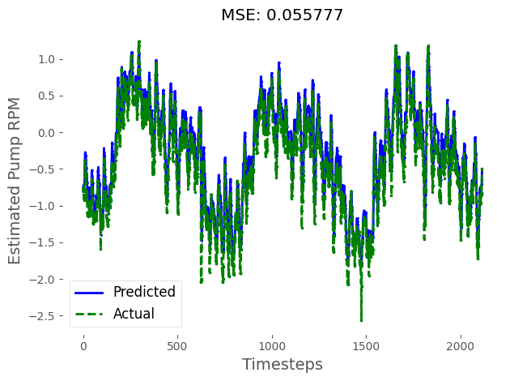
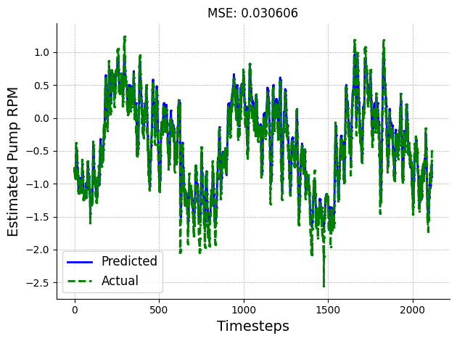
NN loss functions
Mse_loss
L1_loss

Slide 18

NN loss functions
Mse_loss (ReLU)
L1_loss

